Slide 1
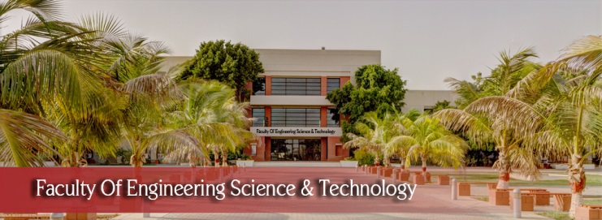

FYP
AI Powered Tourism App
Daniyal Ali
Ali Ahmed
Ahmed Ali
Supervisor: Mr. Iqbal-ud-din
Co-supervisor: Dr. Khurram Iqbal
Department of Computing, FEST
Hamdard University

Slide 2
Summary
Introduction
Problem Statement
Objective
FYP Scope
Our methodology
Key Features
Limitations and Future Work
Use Case Diagram
Working Diagram
ER Diagram
Our Project Plan
Budget / Costing
FYP Deliverables
Conclusion
Acknowledgments

Slide 3
Introduction
The AI-Powered Tourism App is designed to enhance travel experiences by providing personalized recommendations and chatbot assistance. The app helps users plan their trips based on their preferences, ensuring a hassle-free and enjoyable journey. With a user-friendly interface, travellers can explore destinations and get instant support through chatbot integration. By leveraging AI-driven recommendations and interactive features, the app simplifies trip planning, making tourism in Pakistan more accessible and efficient.

Slide 4
Problem Statement
Travelers exploring Pakistan often face difficulties in finding relevant travel information, planning personalized trips and destinations. Traditional travel platforms lack interactive support and tailored recommendations based on individual interests. Our AI-powered tourism app addresses these challenges by integrating a user-friendly interface, chatbot assistance and personalized trip recommendations. This ensures a seamless travel experience, helping users make informed decisions while enhancing accessibility and convenience.

Slide 5
Objective
User-Friendly Interface: Design an intuitive and responsive interface that enhances user interaction and accessibility, making travel planning and navigation seamless and enjoyable.
Chatbot Integration: Implement a conversational chatbot capable of understanding user queries, providing personalized recommendations, assisting with bookings, and offering real-time support throughout the journey.
Trip Recommendations by User Interest: Utilize Recommendation algorithms to analyze user preferences, past travel behavior, and demographic data to suggest personalized trip itineraries, including attractions, activities, and dining options aligned with user interests.

Slide 6
FYP Scope
AI-powered tourism application focused on enhancing user travel experiences through personalized recommendations, travel planning, and real-time updates. The scope of this project explicitly defines what aspects will and will not be considered, along with key assumptions guiding system evolution.

Slide 7
Our Methodology
The development follows the Agile methodology, enabling repeating progress, collaboration, and flexibility. Regular sprints and reviews ensure continuous improvement. Ready-made datasets from trusted sources are used. The Trip Recommendation System provides personalized suggestions through collaborative filtering and user feedback. A chatbot framework enhances user interactions, while Firebase Authentication ensures secure user authentication and data protection.

Slide 8
Key Features
User Friendly Interface – Simple design that is easy to navigate.
Chatbot Integration – Gets travel assistance and queries on demand.
Personalized Trip Recommendations – Recommends destinations based on user preferences.
Firebase Authentication – Make sure that they securely log in and their data is safe.
Itinerary Management: Enables users to efficiently plan and save their trips.

Slide 9
Limitations and Future Work
Limitations:
Requires internet connectivity for full functionality.
AI capabilities are limited to chatbot and basic recommendations.
Recommendations depend on available datasets, affecting accuracy.
Future Work:
Implement offline mode for key features.
Expand data sources to improve recommendation accuracy.
Add multilingual support for a diverse user base.

Slide 10
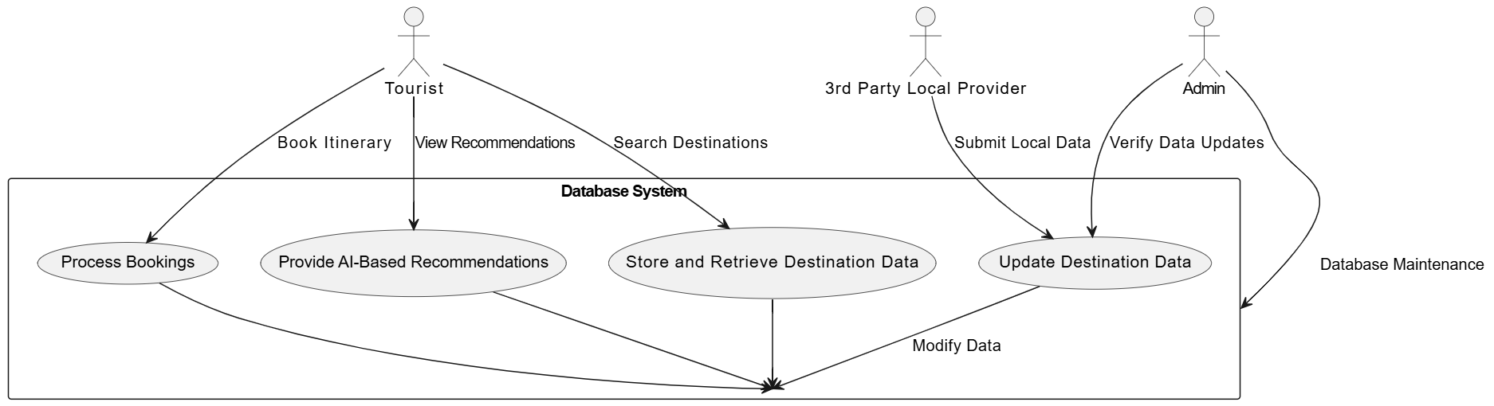
Use Case Diagram

Slide 11
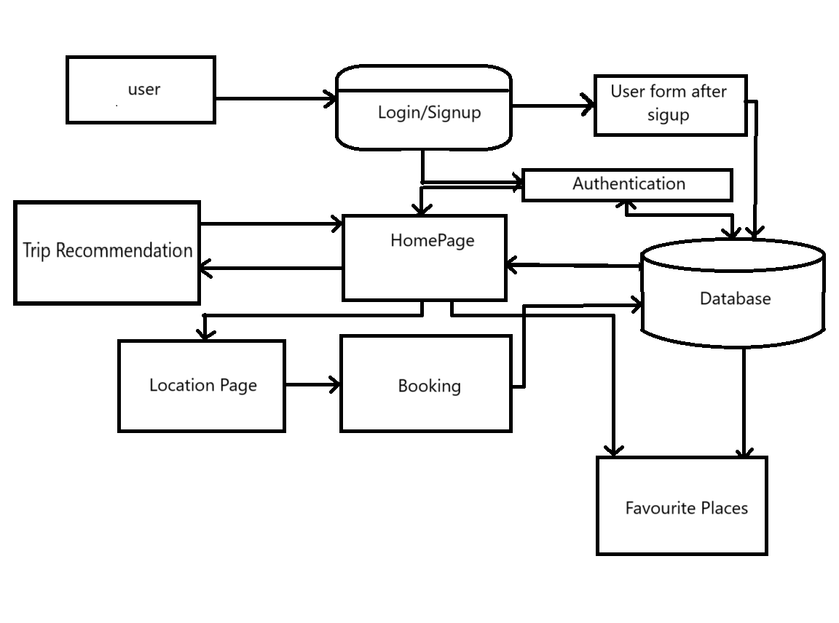
Working Diagarm

Slide 12
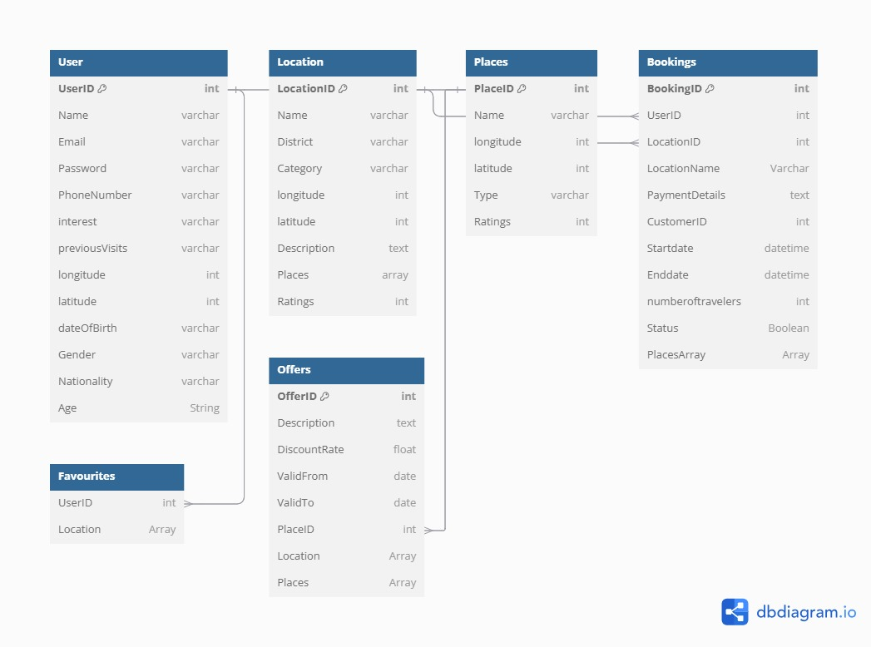
ER Diagram

Slide 13
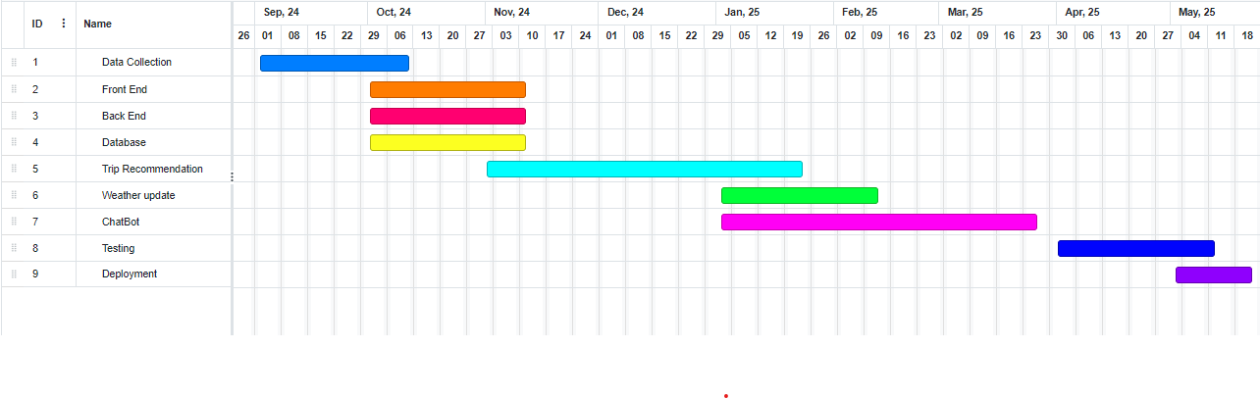
Our Project Plan

Slide 14
Budget / Costing
Software Licenses and Hardware Tools: 0 - 150,000 PKR
Backend Development: Free
Frontend Development: Free
UI/UX Design: 0 - 50,000 PKR (using free design tools like Figma, Sketch offers student discounts)
Project Management Tools: Free (using tools like Trello, Asana)
QA Testing: Free (conducting user tests with peers and mentors)
Marketing and Launch: 0 - 30,000 PKR (basic online promotion)
Legal and Compliance: 0 PKR (assuming no commercial release)
Total Estimated Budget: 0 - 230,000 PKR

Slide 15

FYP Deliverables
FYP-II Evaluation
SRS Document
SDS Document
Project Report - I
Project Plan
Design Mock-up
Front End
Back End
Database
Trip Recommendation System
Chatbot
Testing
Deployment
Project Report - II

Slide 16
Conclusion
AI Powered Tourism App bridges gaps in Tourism Industry.
Centralized and efficient platform for Tourist.
Enhances collaboration and transparency.

Slide 17
Acknowledgments
We’re grateful to our supervisors, Mr. Iqbal-ud-din and Dr. Khurram Iqbal, for their guidance and support throughout this project.

